Slide 1
Agile Communication
Project

Slide 2
Agile Communication
Project
Sprints 1-3

Slide 3
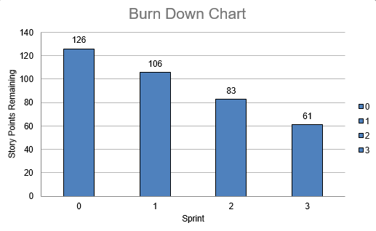
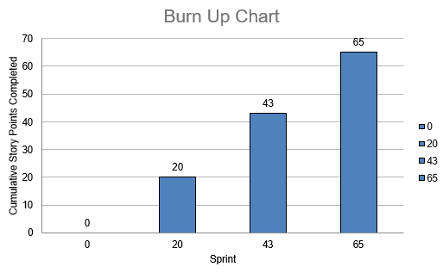
Sprints 1-3 Questions
What is your Velocity for the past 3 sprints?
21
How do you know your Velocity is correct?
VELOCITY = Completed Story Pts/Sprints 20 +23+22 (Story Pts) = 65 / 3 (# of sprints)
What would the BURN DOWN chart look like for Sprints 1-3?
Have included
What would the BURN UP charts look like for Sprints 1-3?
Have included
How many points do you think the Team should commit to for Sprint 4 and justify your answer?
21 or 22

Slide 4
Agile Communication
Project
Sprint 4

Slide 5
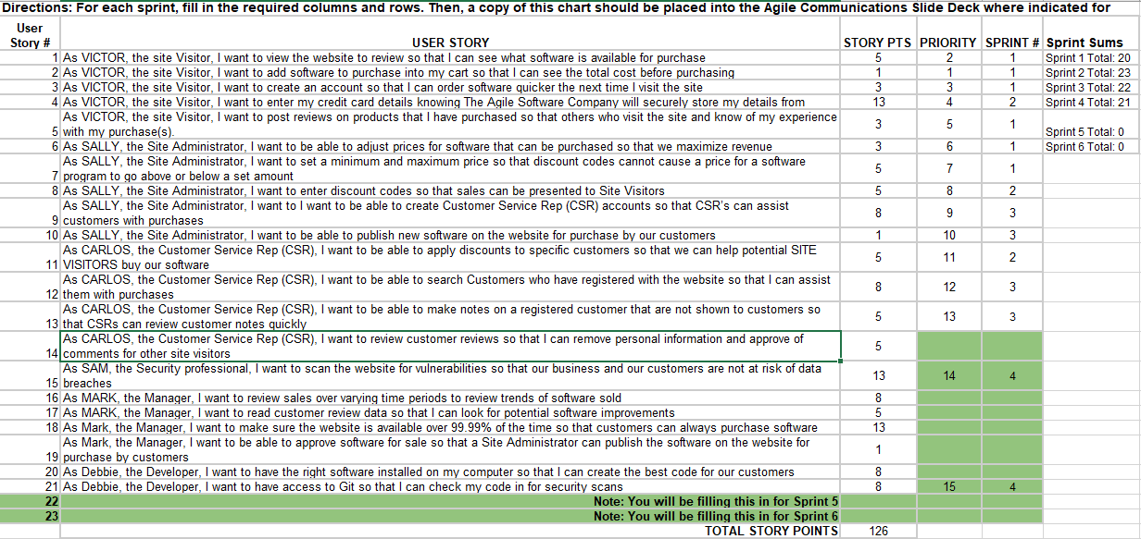

Slide 6
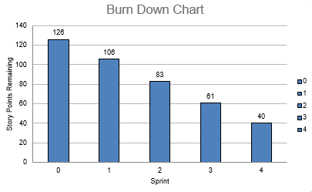
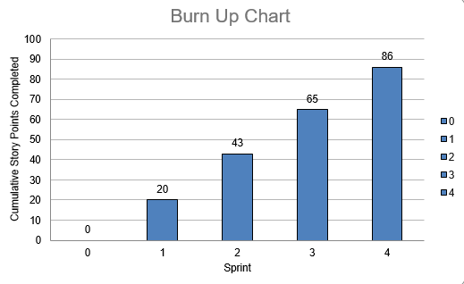
Sprint 4 Questions
What would the BURN DOWN chart look like for Sprints 1-4?
Have included
What would the BURN UP charts look like for Sprints 1-4?
Have included
What Risks did you identify in Sprint 4 and how do they affect the project? (Note: These would be your narrative findings)
The team is focused on addressing CYBERSECURITY issues.
What Theme or Name did you give to Sprint 4?
SecureSprint

Slide 7
The A-Team
Sprint 4 Name
"SecureSprint”
User Stories in Sprint 4
1. Story # 15 with 13 points
2. Story # 21 with 8 points
Total Sprint 4 Points: 21
Narrative: CYBERSECURITY must take top priority. Results: Security-related incidents have been effectively mitigated.
Learnings: Emergency priorities are treated with the utmost importance. Risks: Preventing security breaches remains the top priority. Therefore, the entire sprint was devoted exclusively to addressing security concerns.
SPRINT 4 DEMO of Working Product

Slide 8
Agile Communication
Project
Sprint 5

Slide 9
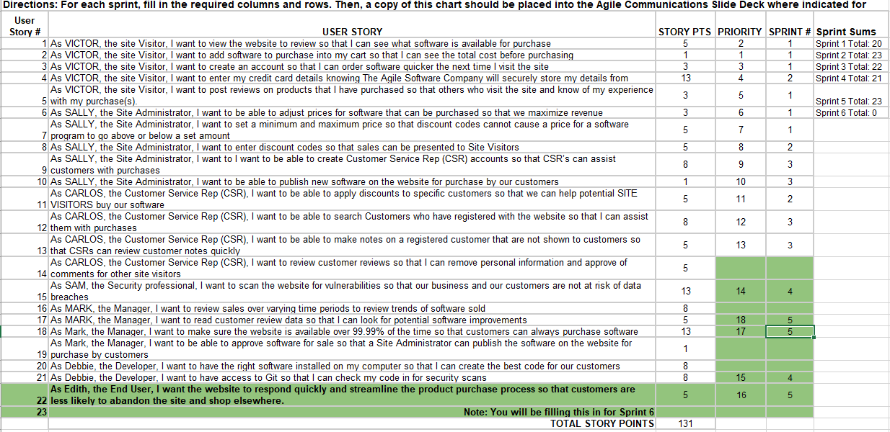

Slide 10
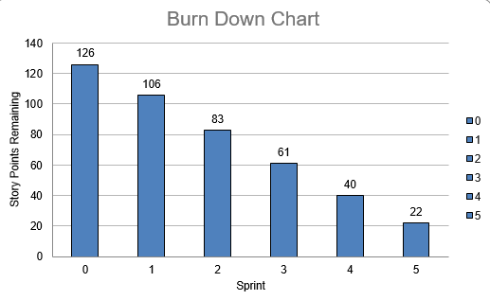
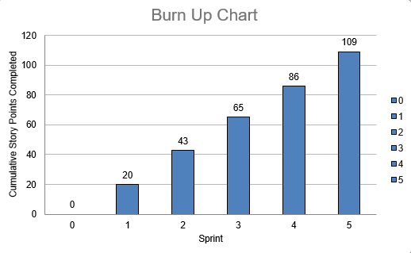
Sprint 5 Questions
What would the BURN DOWN chart look like for Sprints 1-5?
Have included
What would the BURN UP charts look like for Sprints 1-5?
Have included
What Risks did you identify in Sprint 5 and how do they affect the project? (Note: These would be your narrative findings)
The primary risk in Sprint 5 is the potential for dissatisfaction among end users. To address this, I have assigned the highest priority to the user story aimed at enhancing the user experience.
How confident are you in delivering all of the user stories by the end of Sprint 6? Justify your answer.
It’s depend but I am a bit confident that the stories will be delivered on time if nothing unpredictable occurs.

Slide 11
The A-Team
Sprint 5 Name
“Customer Satisfaction“
User Stories in Sprint 5
1. Story # 22 with 5 points 2. Story # 15 with 5 points 3. Story # 18 with 13 points Total Sprint 5 Points: 23
Narrative: Enhance Customer Satisfaction
Results: Streamlined the purchasing process for faster
Learnings: We ensured that user feedback is accessible, allowing us to identify further areas for software improvement.
Risks: The primary risk for this sprint was failing to deliver the value End Users explicitly requested. To mitigate this, we prioritized optimizing the website’s responsiveness above all else.
SPRINT 5 DEMO of Working Product

Slide 12
Agile Communication
Project
Sprint 6

Slide 13
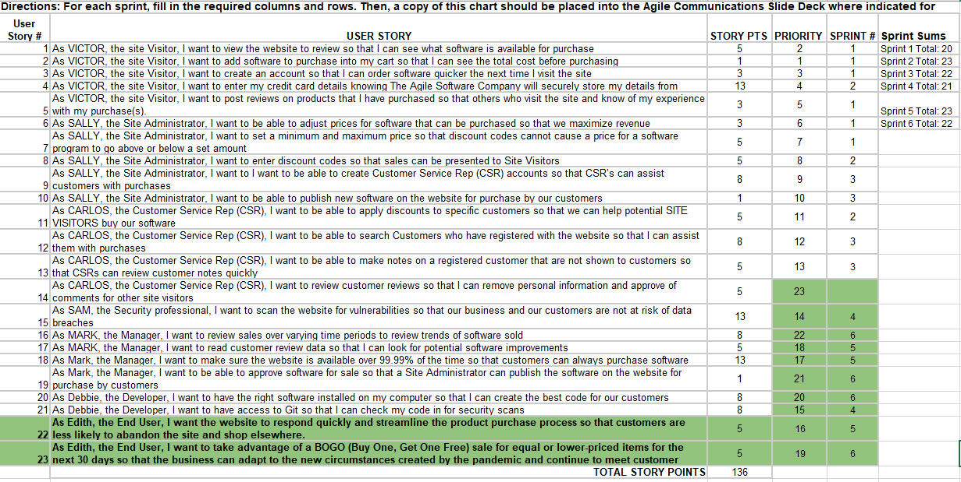

Slide 14
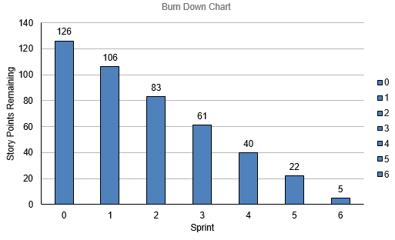
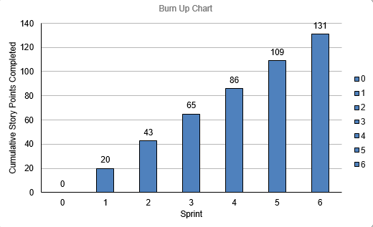
What would the BURN DOWN chart look like for Sprints 1-6?
Have added
What would the BURN UP charts look like for Sprints 1-6?
Have added
Was the Team able to complete all the work in the backlog or did you have to adjust what could be delivered? How would you tell this to Management and justify your answer.
Due to the ongoing pandemic, the team was unable to complete all the planned work. We had to adjust and modify our approach to deliver maximum value to our customers. As a result, we prioritized the BOGO story, which will help the business adapt quickly to the new situation, and decided to postpone story 14. This adjustment enabled us to maintain our velocity while ensuring high quality and sustainability.

Slide 15
The A-Team
Sprint 6 Name
“Keep pace“
User Stories in Sprint 6
1. Story # 23 with 5 points 2. Story # 20 with 8 points 3. Story # 19 with 1 points 4. Story # 16 with 8 points
Total Sprint 6 Points: 22
Narrative: This unprecedented situation led us to prioritize the story that enabled us to adapt our business, remove story related to CSR
Results: We are satisfied with the outcome because delivering value to our customers remains the top priority in our work.
Learnings: Even the most well-thought-out plans must be flexible in the face of global
Risks: Sprint 6 has been challenging due to the ongoing pandemic.
SPRINT 6 DEMO of Working Product

Slide 16
BVIR for Management Questions
Which charts would you want to include in the BVIR that Management would need and why?
Move the Orange boxes to the correct column below
The Burn Up Chart is an excellent tool for management as it clearly shows the value being delivered. Additionally, the Burn Down Chart, due to the team's consistent and strong velocity, is a great way to demonstrate steady and sustainable progress in the project. The Committed vs Delivered Chart is valuable for ensuring that the team is neither adding unnecessary features that increase costs nor delivering less than expected in each sprint. I would avoid including the Story Point Cost per Team, as it may lead us into unnecessary complexities that we don’t want to focus on.
Included
Not included
Burn Down Charts
Burn Up Charts
Committed vs. Delivered Chart
Story Point Cost per Team

Slide 17
Creating the BVIR for Management
Questions to answer before you start the BVIR
What would tell Management if they want to know the details about actual stories?
[Select from the choices below]
"While I understand that you want to get into individual stories and know all the details, we would prefer that Management spends your valuable time guiding and influencing the Roadmap and direction of the project and leave the story delivery to the Teams you have empowered."
Absolutely, let's get into the details!
No, that is none of your business
Which of the above did you choose (1,2,3) and why?
My choice: Option 1 Reasoning: This response emphasizes the importance of Management focusing on the bigger picture—guiding the project's overall direction—while trusting the teams to handle the execution of individual stories. It promotes empowering teams and fostering a strategic approach, rather than micromanaging the details, which can help maintain productivity and morale.

Slide 18
Creating the BVIR for Management
Questions to answer before you start the BVIR
Is it project considered a failure because backlog items still remain? Explain.
No, a project is not considered a failure simply because backlog items remain. The presence of remaining backlog items can be normal, especially they are low-priority and have been deprioritized in favor of higher-value work during the sprint or project timeline.

Slide 19
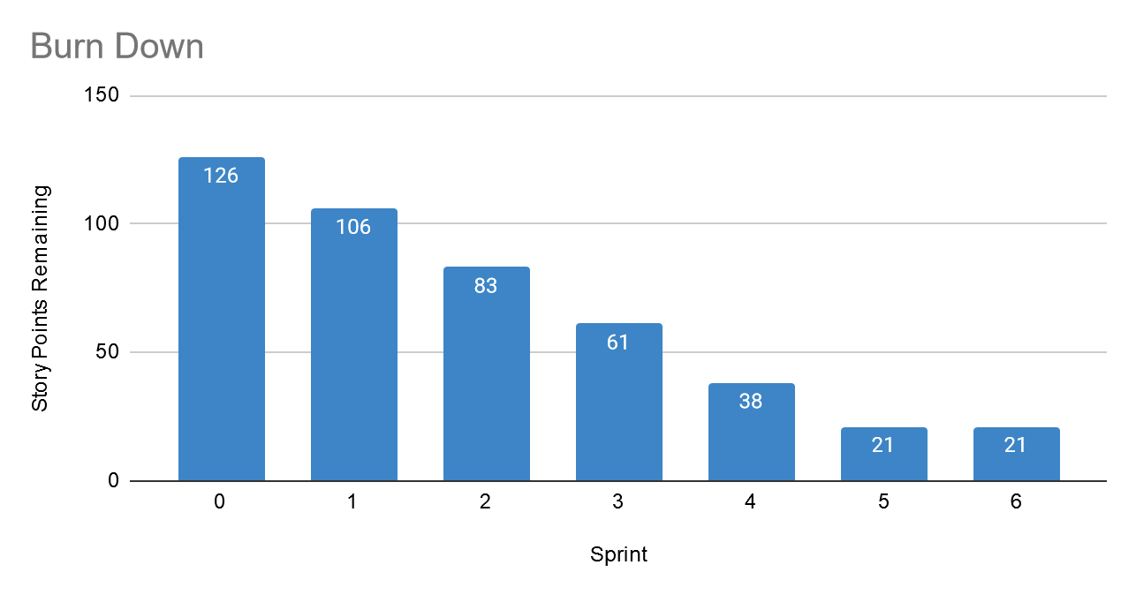
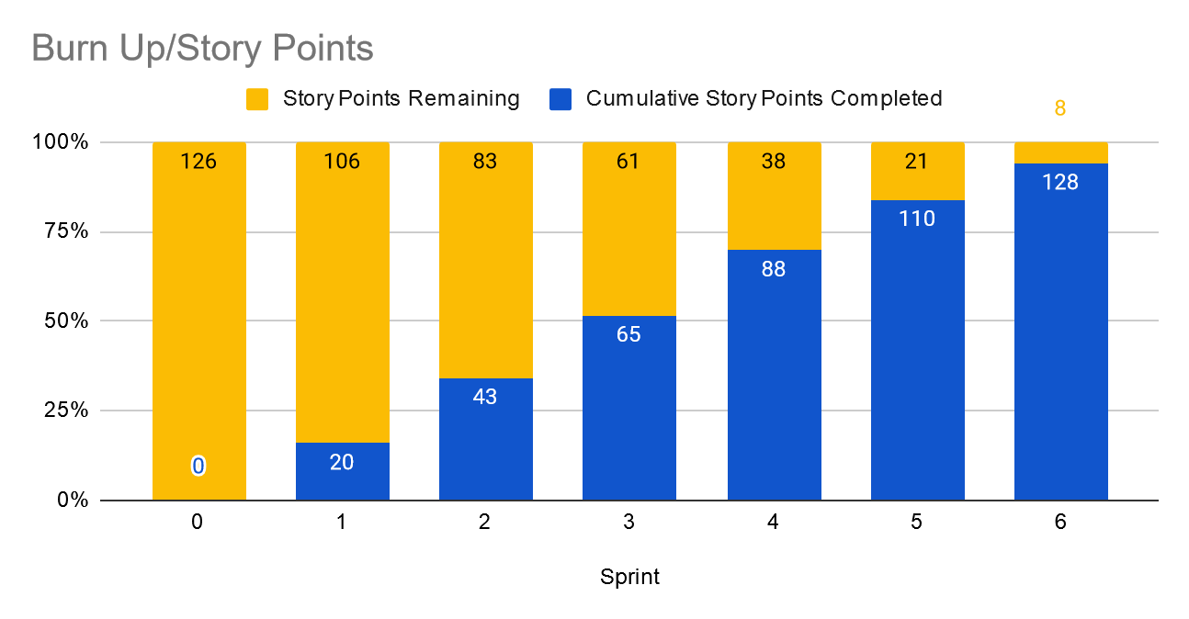
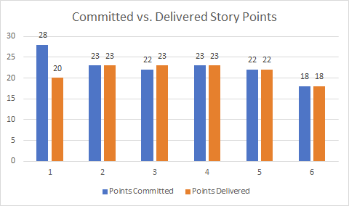
Creating the BVIR for Management
Instructions:
Start by creating your own BVIR. From the charts and sections below, please drag and drop items you would like to display to convey the story behind the MVP project
[Cut and paste items from this section and add them to the next slide. Remember to fill in information in the boxes where it is needed]
Roadmap
MVP VISION
Team Name
Chart Comparing Sprint Velocity of Teams 1 vs Team 2
Chart showing cost per story point

Slide 20
BVIR for Management
[Use this slide to create your BVIR. We have not provided a template for this, you get to decide what it looks like using the information from the previous slide]
MVP VISION
Team Name
Roadmap

Slide 21
BVIR for Management
[Now that you have created your BVIR for management, you need to create a video or written narrative explaining the MVP delivery status.
Use this slide to write your narrative or plan what you want to say in your video. ]
Include (at the minimum) the following:
Team Name: The A-team
Vision: Our vision is to build a modern, scalable website using modular design, containerization, and cloud technologies to enhance user experience and performance. We aim to deliver a high-quality MVP for customer feedback, ensuring seamless functionality and adaptability.
Sprint Burn Down Charts for Sprints 1-6

Slide 22
BVIR for Management
4. Sprint Burn Up Charts for Sprints 1-6
5. Project status (complete / incomplete): The project status is considered complete, even though one story is missing. We have successfully provided a solid projection of the final product.

Slide 23
Questions from Management (Using Videos would be great!)
Instructions:
Watch the videos in the classroom.
Record your videos or provide your answers below. Remember to justify your answer.
[Video # 1 Answer] The project status is considered complete, even though one story is missing. The key to success is delivering highest value to the customer, which is more important than achieving a perfect product. What we have built already provides significant value and addresses the customer's highest-priority requests.

Slide 24
Questions from Management (Using Videos would be great!)
Instructions:
Watch the videos in the classroom.
Record your videos or provide your answers below. Remember to justify your answer.
[Video # 2 Answer] The pandemic has created a challenging scenario, so we need re-prioritized out story points. Ignoring the customer's requests may have disappointed them, but our focus was on delivering the highest value to them.

Slide 25
Questions from Management (Using Videos would be great!)
Instructions:
Watch the videos in the classroom.
Record your videos or provide your answers below. Remember to justify your answer.
[Video # 3 Answer]
Adopting Agile, the team works collaboratively to deliver the most value in a sustainable manner. We prioritize work based on the value it brings to the customer and focus on completing the most important tasks within the given time frame. The decision to not complete all the work is aligned with our commitment to delivering a high-quality product without compromising the team's well-being or the long-term sustainability of the project. We don't push the team to work 24/7 because that would undermine our ability to deliver consistent value over time. It's important to maintain a healthy balance to ensure continuous improvement and high morale.

Slide 26
Questions from Management (Using Videos would be great!)
Instructions:
Watch the videos in the classroom.
Record your videos or provide your answers below. Remember to justify your answer.
[Video # 4 Answer] I would recommend a final sprint, even a short one of one week, to complete the remaining 5-point story. This would allow us to quickly finish the outstanding work and transition immediately to the new high-priority project.

